Slide 1
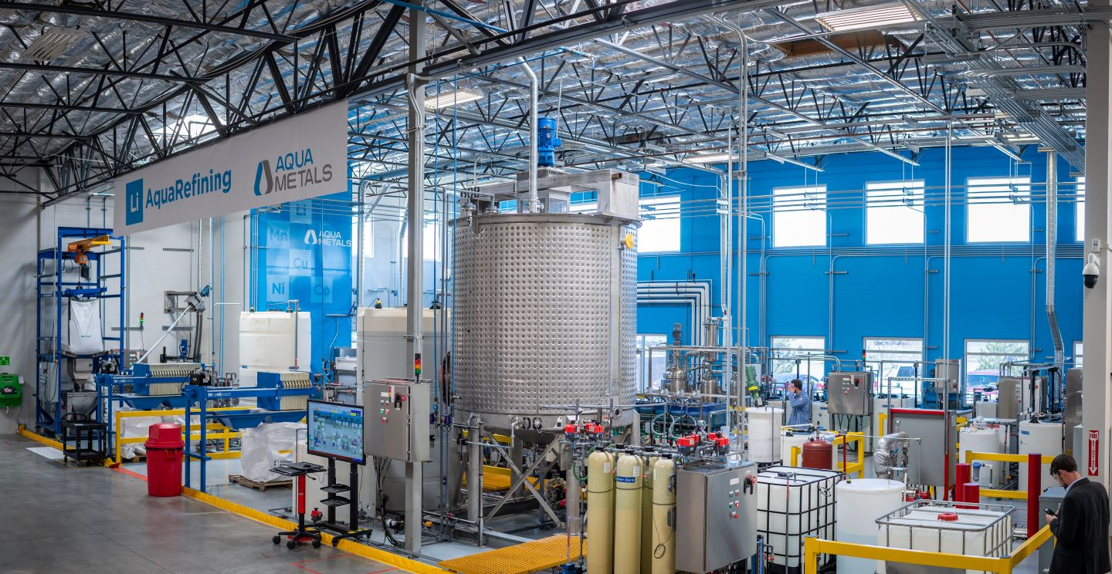
NAATBatt Meet the Recyclers - 2024

Slide 2
Aqua Metals: A Pioneer in Sustainable Lithium Battery Recycling
Essential for Clean Energy: Pioneering the first sustainable lithium battery recycling technology, vital for the energy transition and clean energy economy.
Rapid Market Growth: Company is positioned to capitalize on the booming domestic battery manufacturing and growing EV sales, which are growing demand for battery materials and recycling operations.
Innovative Technology: Proven at pilot scale, the first commercial-scale recycling facility using our groundbreaking AquaRefining™ process is underway – entering production 2025.
Market Potential: Over 1.2TWh of battery manufacturing expected in North America alone by 2030, driving immense growth opportunities to recycle from and supply to domestic manufacturing.
Closed-Loop Ecosystem: Partnering with leading companies in battery manufacturing and materials to produce low-carbon, incentive-eligible battery metals domestically for the first time.
5

Slide 3
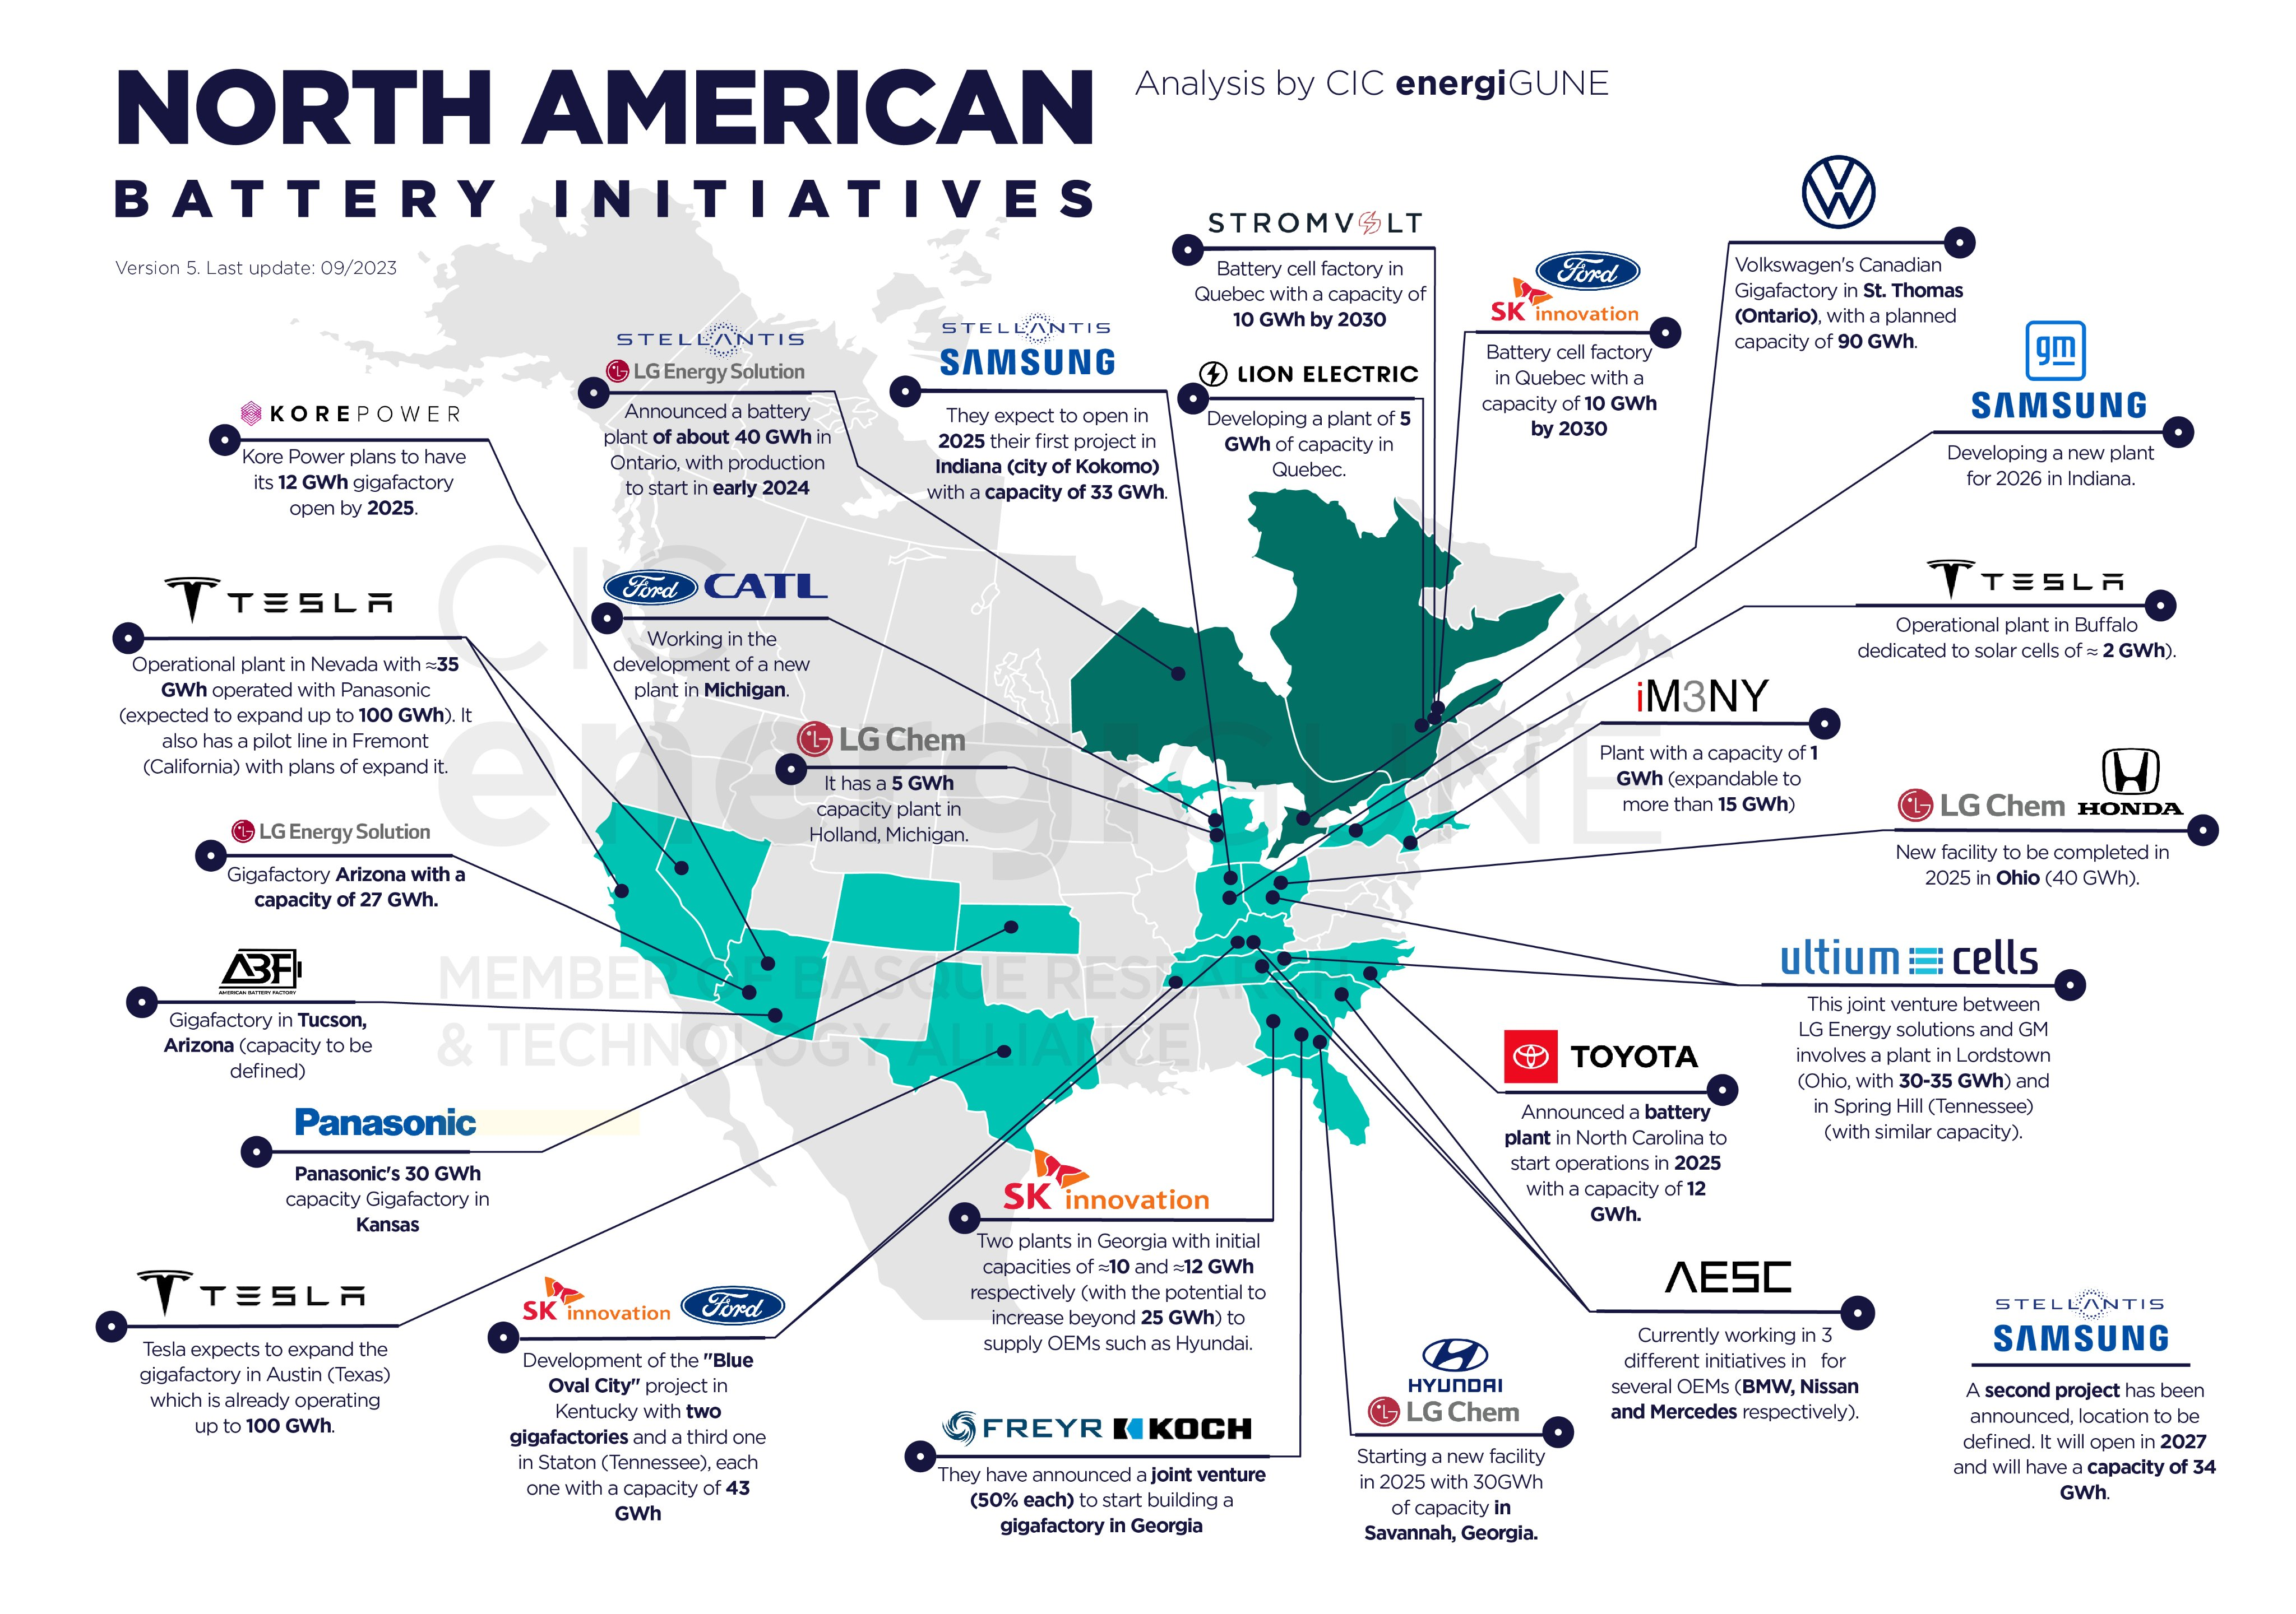
Rapid Expansion of North American Battery Industry
By 2030, the US alone is projected to have more than 1.2 terawatt hour of lithium battery cell manufacturing
Enough for 16M electric vehicle each year
$92B total investment and counting
80+ processing & manufacturing facilities
Supply chain for lithium batteries is growing rapidly throughout North America
Creating immense demand for critical minerals
Requiring significant new battery EOL and recycling infrastructure
5

Slide 4
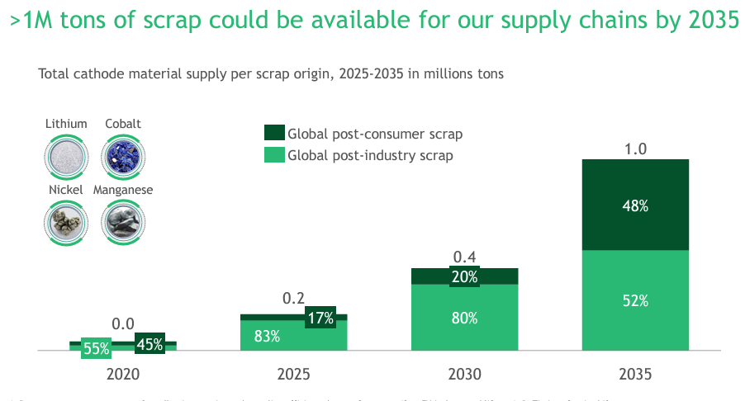
End-of-Life + Manufacturing Scrap Growing Rapidly
Data from Boston Consulting Group

Slide 5
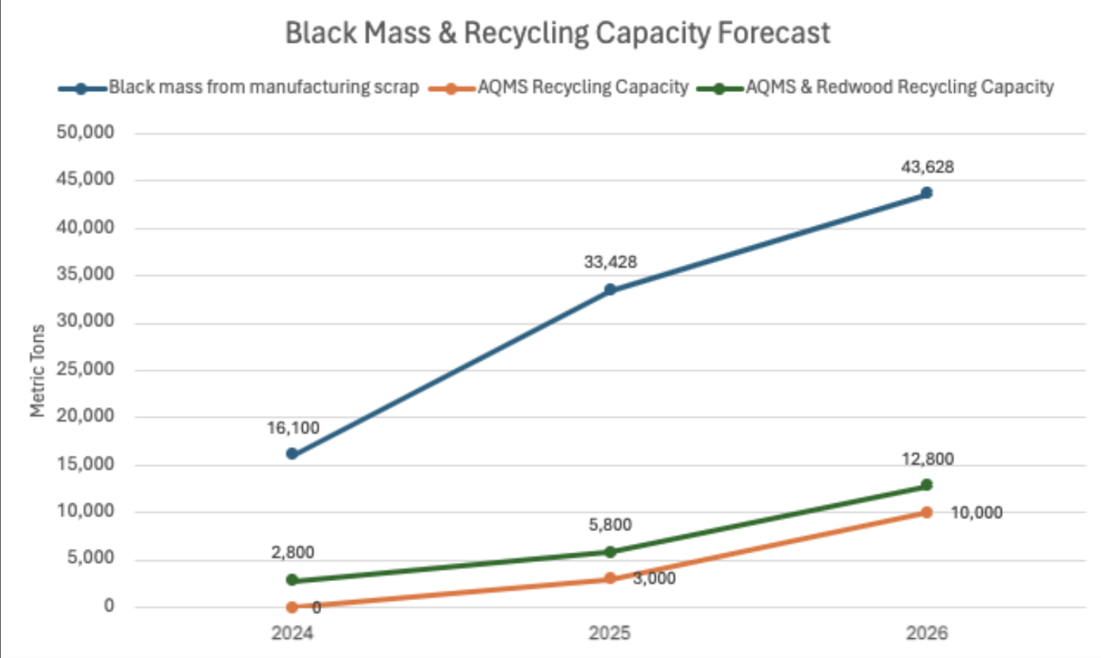
US Manufacturing Scrap > Announced Recycling Capacity
Rapidly expanding battery manufacturing increases scrap supply
Scrap is high purity = more revenue per tonne
The combined announced recycling capacity in the US will be less than expected scrap alone – not even counting end-of-life
Only Aqua Metals + Redwood Materials will be at meaningful scale in next few years
Based on internal AQMS market intelligence

Slide 6
The Next Generation Recycling Process
Replaces furnaces and heavy chemical use with 100% electricity-powered and closed-loop recycling, creating fundamentally non-polluting, cost-efficient solution that generates minimal waste
Recovers the high-value metals lost in smelting (like lithium and manganese), and produces high purity products
Safer work environment, less hazardous materials, eliminates constant trainloads of chemicals
Proven for LABs and expanding to LiBs
The only recycling process that:
Produces lithium hydroxide directly (or Li2CO3), reclaims high purity metals (not salts), regenerates chemicals used in closed-loop system, and has a clear pathway to net-zero operations
Strong IP protection:
73 global patents
43 patents pending
Notes:
Design so not a word wall

Slide 7
Current LiB Recycling Technology Comparison
Smelting approach is currently a multistep pyro. Emissions will be unsustainable long term as recycling volume increases.
Co
Li
Ni
Cu
Mn
PYRO
X
X
Cathode
Precursors
Significant carbon pollution, toxic emissions
Produces metal alloys needing further refinement
Does not recover lithium or manganese
Batteries
Furnace
Combined product of cobalt and nickel
Furnace
Separation step
Furnace
Refining/Precursor step
HYDRO
Not commercially proven. High waste streams and high embedded emissions in one-time-use chemcials
CoSO4
Li
NiSO4
CuSO4
MnSO4
?
Cathode
Precursors
Unproven at scale, high risk pathway
Recovers sulfates & salts, not pure metals
Immense embedded emissions in chemicals
Tons of unmitigated sodium sulfate waste
Batteries
Break and Separation
Black Mass Creation
Chemical precipitation - not proven at scale
AQUAREFINING
Expected to be economically and environmentally superior, producing higher quality product with better yield.
Co
LiOH or Li2CO3
Ni
Cu
MnO2
Cathode
Precursors
Produces high-purity metals for any pCAM/CAM
Eliminates need for trainloads of chemicals
No sodium sulfate waste streams to landfill
Multiple pathways (LiOH, Li2CO3, salt conversion)
Batteries
Break and Separation
Black Mass Creation
AQUAFREFINING
High purity metals plated
Copyright © 2023 Aqua Metals, Inc. All Rights Reserved.

Slide 8
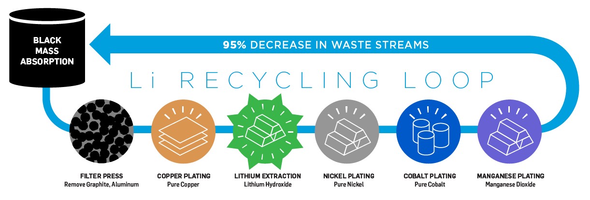
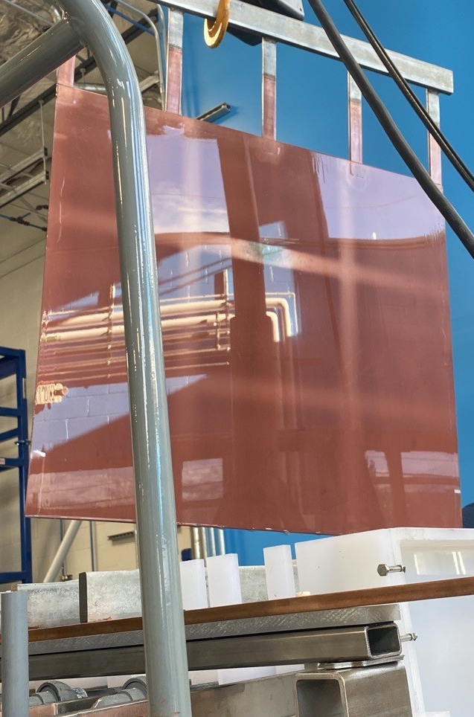
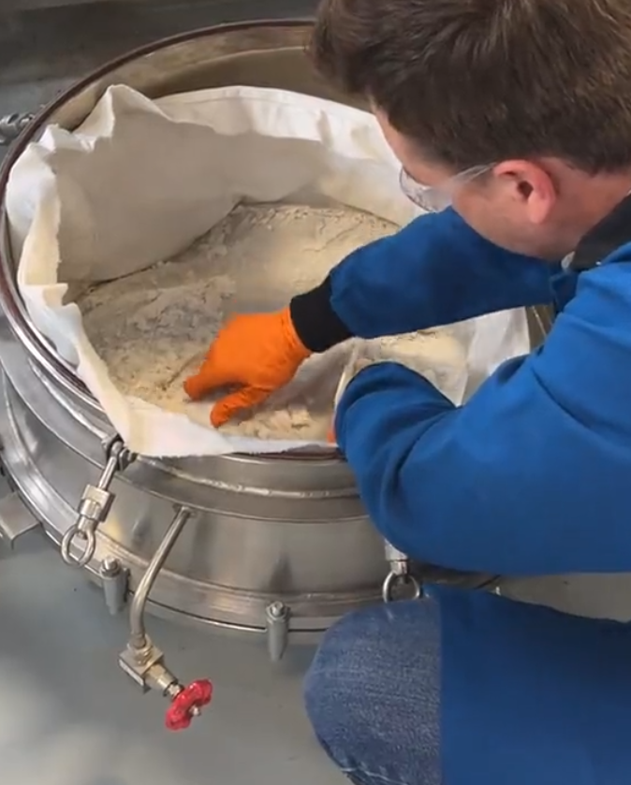
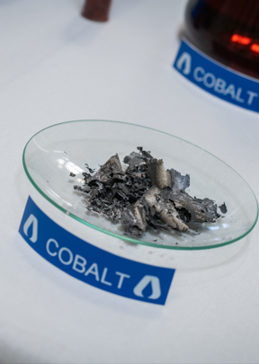
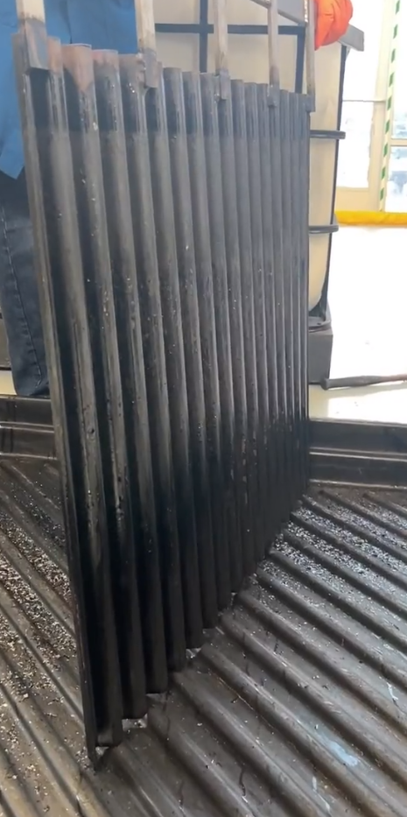
Li AquaRefining: First Sustainable LiB Recycling Process
Li AquaRefining™ recovers critical materials using electricity in a closed-loop system
99% less CO2 than pyro or mining and no polluting furnaces
95% less chemicals than hydro, regenerative process lowers costs and emissions
95%+ recovery rate of all valuable materials
Sourced Black Mass
Pure Copper Plating
Lithium Crystallization (LiOH - Pictured) or Carbonation (Li2CO3)
Pure Nickel Plating
Pure Cobalt & Manganese Dioxide Co-Plated

Slide 9
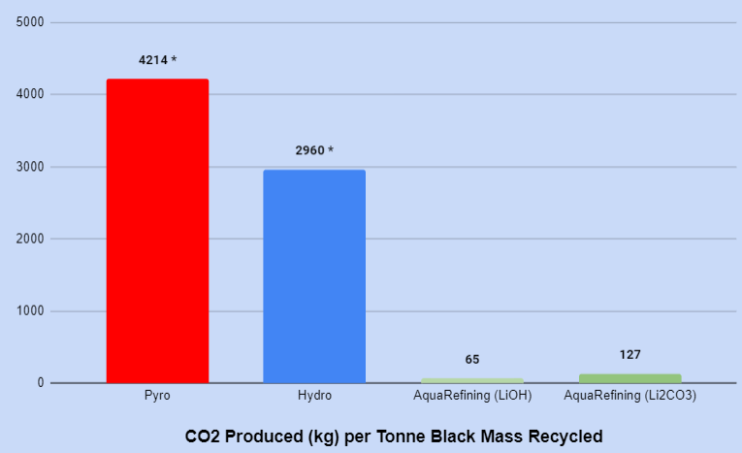
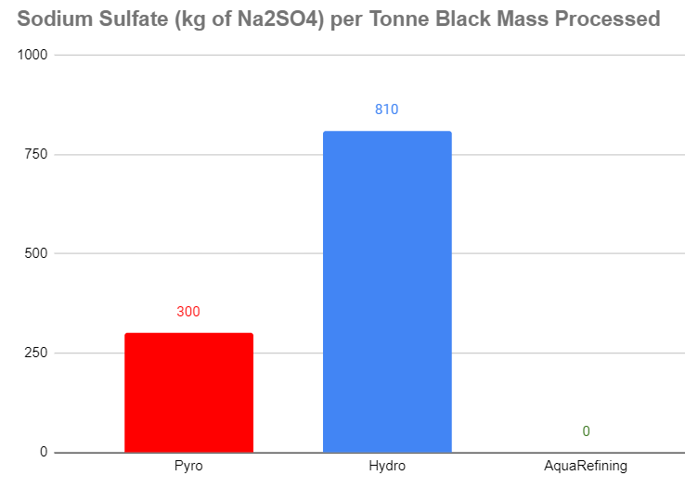
Game Changing Environmental & Economic Performance
Electrifying lithium battery recycling to reduce emissions and waste
Aqua Metals’ Li AquaRefining technology uses dramatically less energy – powered by electricity, instead of fossil fuels
Much lower emissions per tonne recycled than pyro- and hydrometallurgical processes
AquaRefining also produces substantially less waste than competing solutions – and no sodium sulfate
*Based on Argonne National Labs battery life-cycle model —EverBatt

Slide 10
Aqua Metals’ AquaRefining Pilot Reno, NV: 75-100 tonnes per year

Slide 11
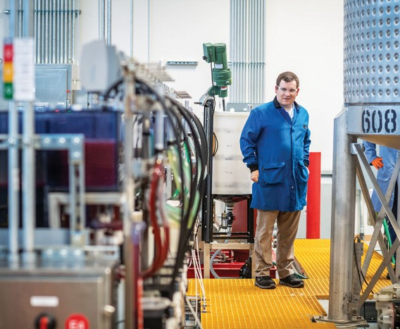
Sustainable LiB Recycling Pioneers
Electrifying the next generation of lithium battery recycling
AquaRefining: The first sustainable battery recycling solution, a regenerative form of electro-hydrometallurgy
An innovative application of electroplating – recover critical metals by plating them in electrochemical cells
No furnaces, no one-time-use chemicals, no Na2SO4 waste, and regenerates proprietary solution
Low-Carbon: No direct emissions, sourcing clean electricity to power operations & processes
Pilot operational 24x5 (75-100tpy) and produces in spec product

Slide 12
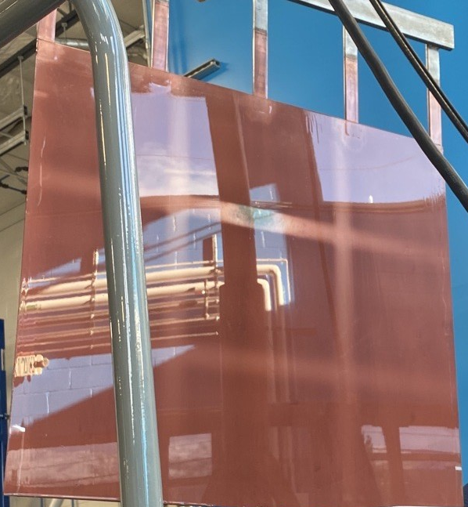
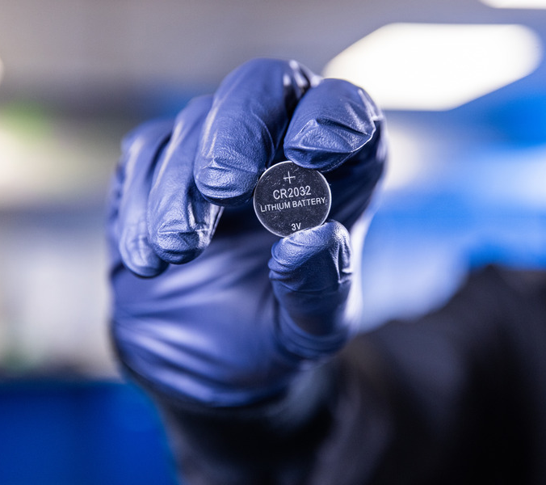
Sustainable LiB Recycling Pioneers
Electrifying the next generation of lithium battery recycling
Recovers pure metals (Co, Cu, Ni) instead of battery metal salts, achieving LME purity
Ability to deliver to various CAM/battery manufacturers, not spec’d to one customer
Recovering sulfates or salts at battery spec will be difficult, yet unproven at scale
Pure metals valuable in multiple industries
AquaRefining also produces either lithium hydroxide or carbonate, depending on application, and manganese dioxide
Battery grade and validated by lithium battery manufacturer
Electroplated copper recovered from black mass
An LFP cell made from Aqua Metals recycled lithium (Dragonfly Energy)

Slide 13
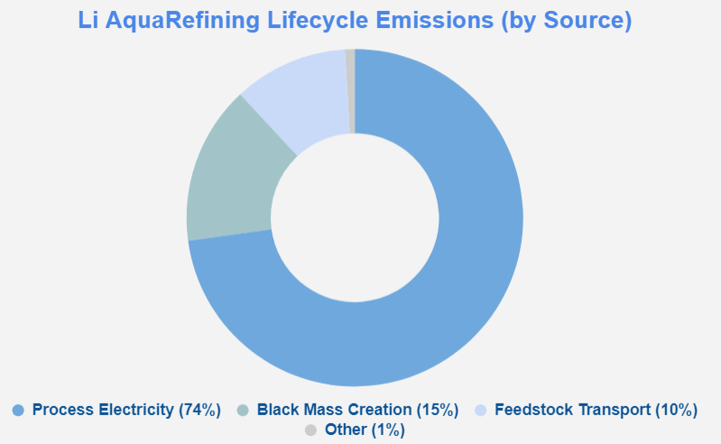
Pilot Recycling Operations Lifecycle Analysis
Independent Technical Report conducted by global engineering firm ICF International including Lifecycle Analysis (LCA) of Aqua Metals’ AquaRefining Pilot
Technical Report Conclusions:
AquaRefining shows a more than 95% reduction in climate emissions vs. mined materials
Additionally, 83% reduction in carbon emissions vs. current hydrometallurgy recycling methods
Aqua Metals Pathway to Zero Carbon:
~75% of current emissions from grid electricity
Sourcing carbon-free electricity lowers CO2 even further – beyond capabilities of other battery recyclers
~25% from feedstock creation & transport
Partnerships with low-carbon black mass producers actively reducing emissions
Lower climate emissions by design, and a clear pathway to net-zero LiB recycling

Slide 14
Sierra ARC Commercial Scale Facility Update
19

Slide 15
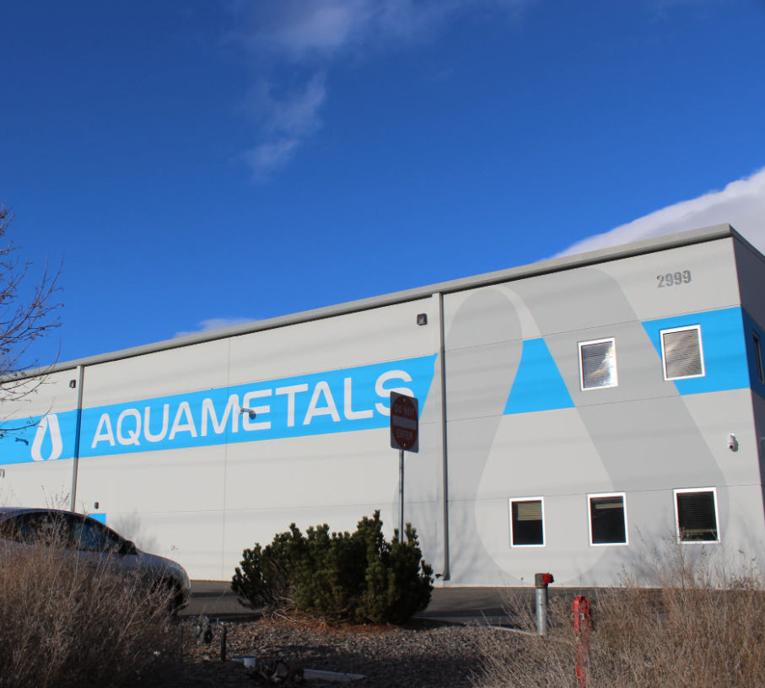
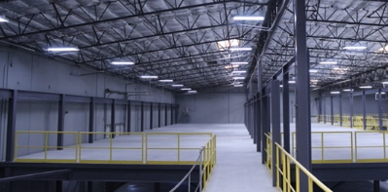
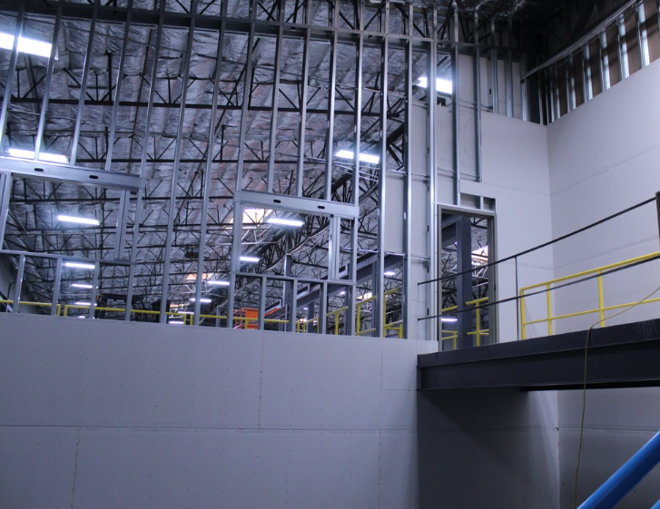
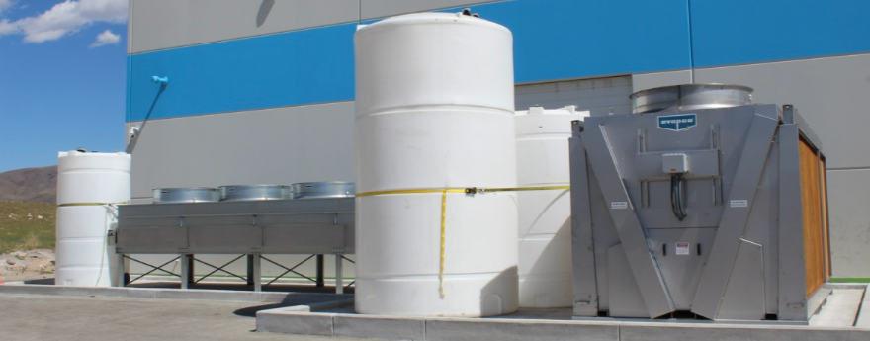
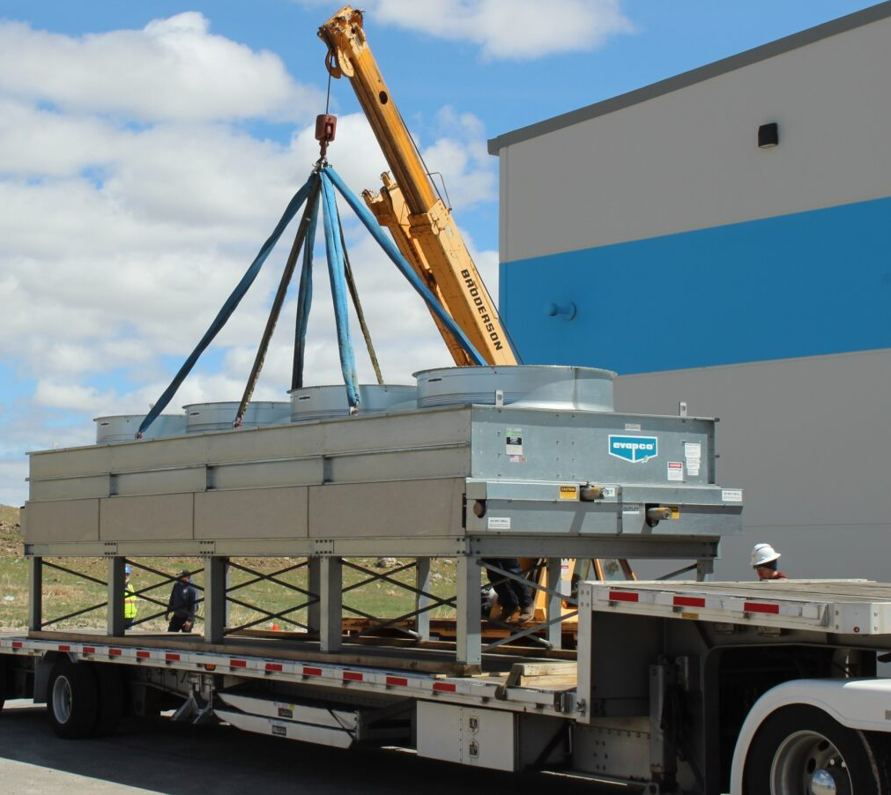
Upfitting Completion + Equipment Being Delivered
Tahoe-Reno Industrial Center
10,000 tonnes-per-year target capacity
Full campus operational by 2028
15
19

Slide 16
Expanding Partner Ecosystem
PROVIDING SAMPLES TO MANUFACTURERS AND SUPPLIERS THROUGHOUT THE BATTERY SUPPLY CHAIN
Leading Battery Materials Co. in South Korea
SK’s largest black mass facility, expanding to 24,000tpa
Strategic investment and partnership
Established partner w/ SK’s battery & EV companies
Leading LFP Battery & Energy Storage Company
Lithium Ferro Phosphate (LFP) & Solid-State Battery Tech
Validated Aqua Metals materials as part of advanced manufacturing process
Next Steps:
Advance LOI to a formal agreement for regional (NV) supply chain & off-taker for recycled lithium
Innovative Battery Materials Manufacturer (CAM/pCAM)
Building 13,000tpa PlusCAM facility in Jackson, TN
Executed a long-tern strategic supply agreement
Aqua Metals has already delivered recycled materials for testing, samples
Next Steps::
Commence nitration pilot plant development, co-location agreement
Next Steps:
Yulho Materials completing commissioning of black mass processing facility
AQMS & Yulho executing large-scale, AquaRefining licensing agreement for Korea
22

Slide 17
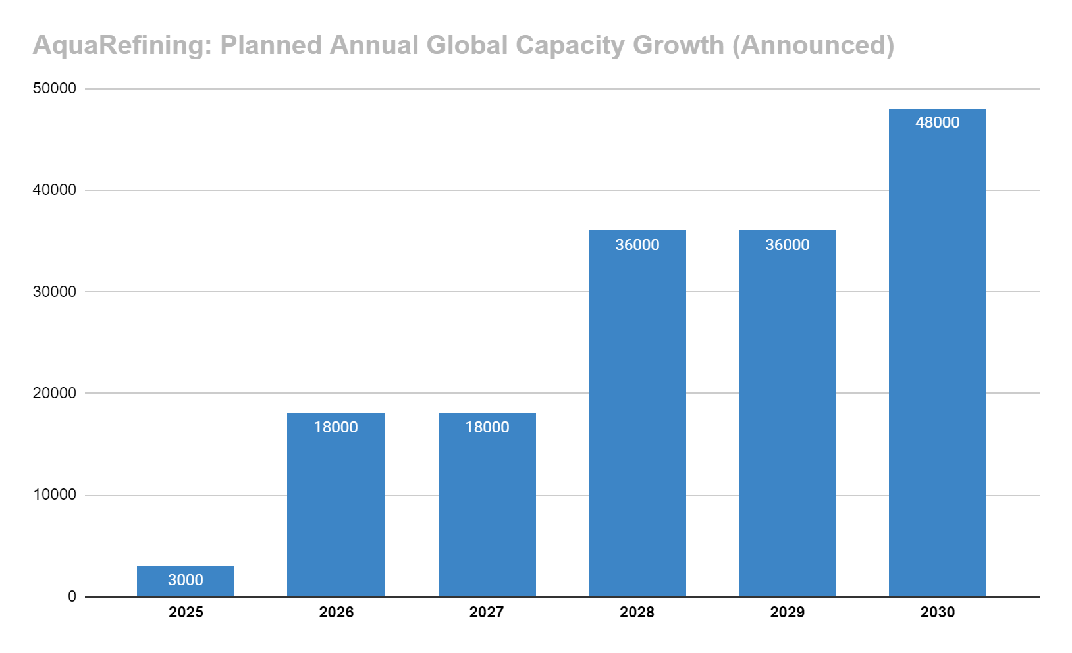
AQUA METALS GLOBAL GROWTH
AQUA METALS IS DEVELOPING AND PARTNERING ON SUSTAINABLE RECYCLING GLOBALLY
Combined capacity across all announced projects to date
Wholly-owned, JV, and license models all being developed
Includes Sierra ARC and co-location with 6K Energy in U.S., and licensed facilities in Asia with Yulho Materials

Slide 18
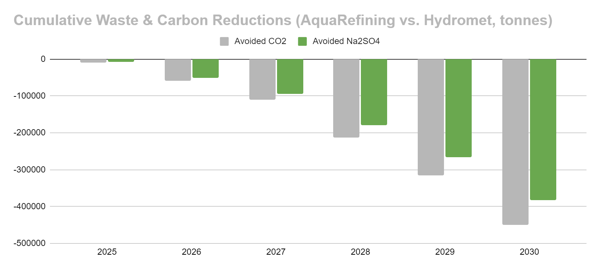
AS RECYCLING SCALES – MUST BE SUSTAINABLE
KEY FOCUS ON REDUCING EMISSIONS AND LANDFILL WASTE TO CREATE CIRCULAR LiB RECYCLING
380,000
450,000
*CO2 Based on Argonne National Labs’ battery life-cycle model (EverBatt) & Na2SO4 estimates from SGS Mineral Services

Slide 19
Investor Highlights
Patented recycling solution that has the potential to deliver the best economics and lowest environmental impact
Surging demand
EVs, mobile devices, solar storage, everything uses batteries, and demand is rapidly growing.
Innovative solution with operational pilot proving technology, and plans for commercial-scale campus
Massive and growing global addressable market
Greenfield opportunity for partnerships and strategic alliances
Battery component deficit
Aqua Metals is building the necessary infrastructure to electrify the economy – and Asia is leading the race.
Strong IP protection:
73 global patents; 43 patents pending
Only electro-hydrometallurgy recycler in North America
Adaptable business models (build & operate, joint venture, license)
Only Li-Ion recycling method with pathway to net-zero operations
Environmental disaster
Legacy recycling methods are dirty, hazardous, and inefficient. Current lithium-ion recycling produces far more carbon pollution and landfill waste than valuable material recovered.
AquaRefining recovers all valuable materials, including Lithium Hydroxide and Manganese Dioxide, which are not recovered by competing methods
Copyright © 2022 Aqua Metals, Inc. All Rights Reserved.

Slide 20
NASDAQ: AQMS
WWW.AQUAMETALS.COM
For Business & Partnership Inquiries:
Dave McMurtry
Dave.McMurtry@AquaMetals.com
Copyright © 2022 Aqua Metals, Inc. All Rights Reserved.

