Slide 2
ReElement Technologies Corporation
A Subsidiary of American Resources Corporation (NASDAQ: AREC)
Forward-Looking Statements
This document may include predictions, estimates or other information that might be considered forward-looking. While these forward-looking statements represent our current judgment on what the future holds, they are subject to risks and uncertainties that could cause actual results to differ materially. You are cautioned not to place undue reliance on these forward-looking statements, which reflect our opinions only as of the date of this presentation. Please keep in mind that we are not obligating ourselves to revise or publicly release the results of any revision to these forward-looking statements in light of new information or future events. Throughout this document, we will attempt to present some important factors relating to our business that may affect our predictions. You should also review any and all SEC filings of each respective company for a more complete discussion of these factors and other risks, particularly under the heading “Risk Factors.”
This document is neither an offer to sell nor a solicitation to purchase any of the Company’s securities. Certain statements and financial projections in this Presentation constitute "forward-looking statements" within the meaning of the Private Securities Litigation Reform Act of 1995. Forward-looking statements, which are based on management’s current expectations, are generally identifiable by the use of terms, such as “anticipates,” “believes,” “could,” “estimates,” “expects,” “intends,” “may,” “plans,” “possible,” “potential,” “predicts,” “projects,” “should,” “would” and similar expressions. The potential risks and uncertainties that could cause actual results to differ materially from those expressed or implied herein include, among others, the Company’s ability to raise additional debt or equity financing, the Company’s relationships with its current and future customers and business partners, the Company’s ability to achieve anticipated results from acquisitions, and organic growth and development and overall business expansion. All reserve estimates (tonnage, quality, sell ability, etc.) and other number and figures presented herein are management estimates only, may include reserves that are currently under lease negotiation (i.e., not currently controlled), and should be independently verified.
The non-reserve deposit numbers presented herein are estimates based on available data and the interpretation of such data by the company and/or its advisors and/or consultants and are not classified as “proven” or “probable” pursuant to the definitions found within SEC’s Industry Guide 7. Not all non-reserve deposits are permitted, and certain reserve numbers may include figures under permit, permit in-process or leased, and in some cases prior leases that have lapsed and need to be re-obtained.
This presentation and the information herein is updated frequently, and you should absolutely verify with management of the Company that this version is the most recent available. In the event the information presented herein conflicts with Company public filings, the public filings shall be the governing document.

Slide 3
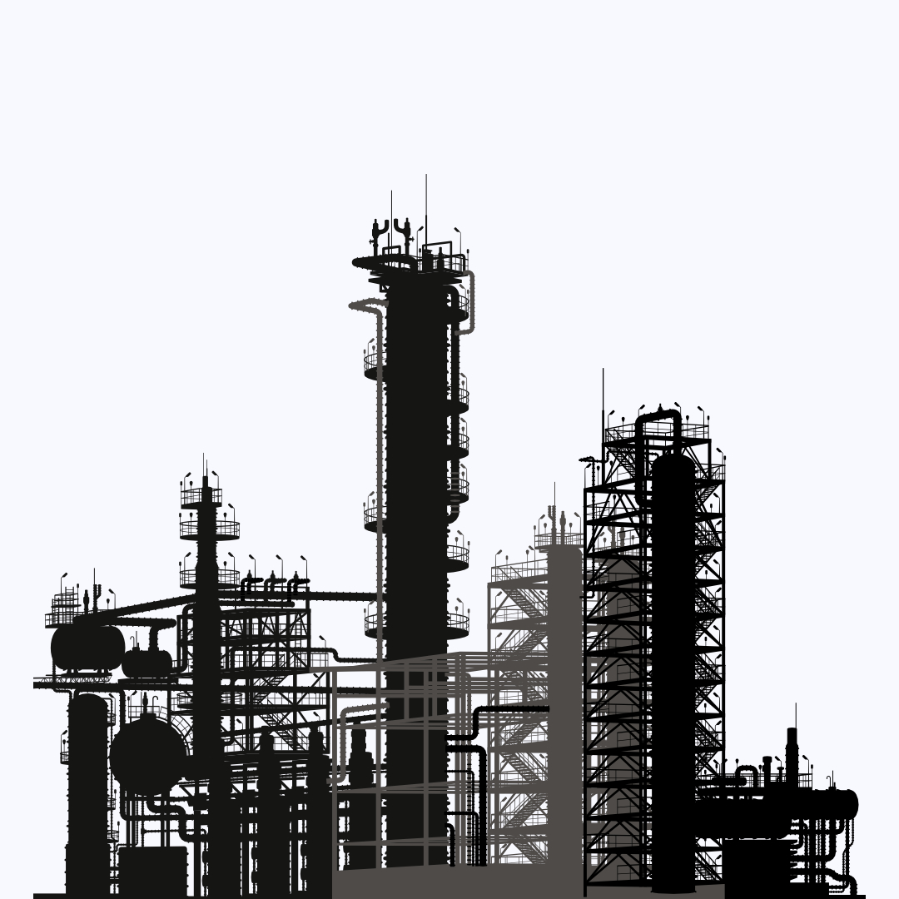
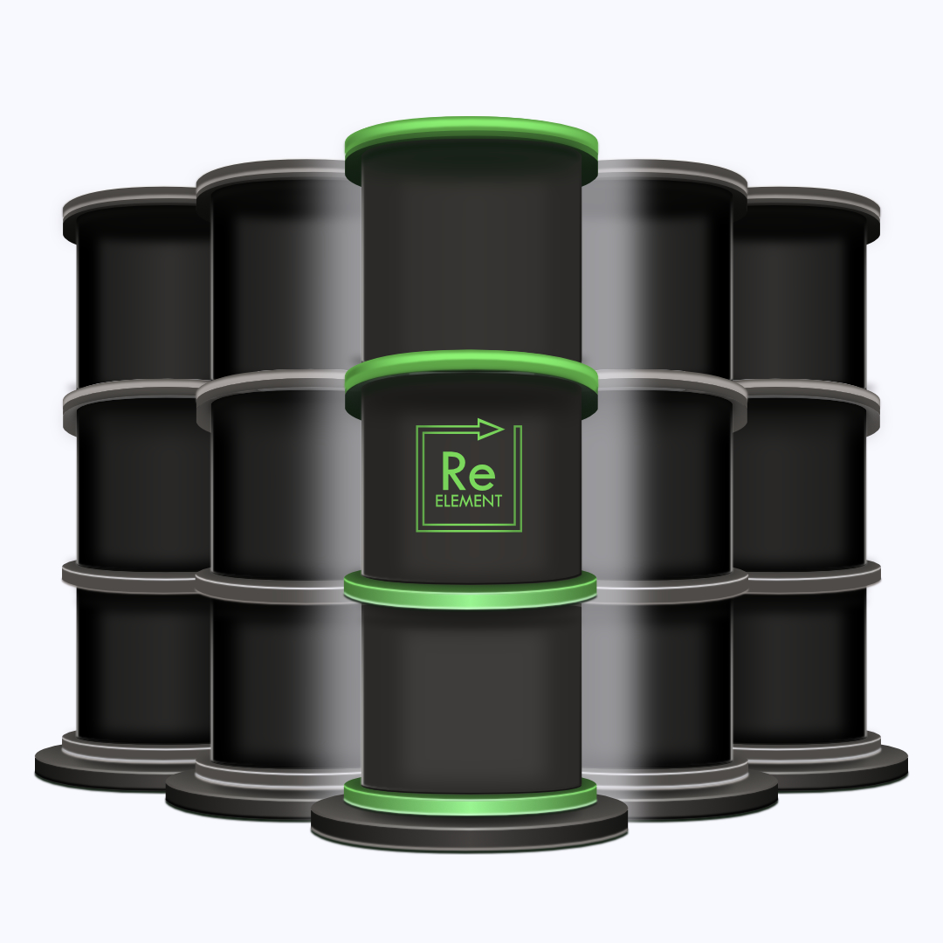
Chromatography: Separation & Purification
A Novel Approach to a Proven and Longstanding Technology with High-Performing Results
Current Industry Standard: Solvent Extraction: Requires > 100 mixer settlers with a large amount of toxic waste discharged creating some of the most polluted sites in the world
ReElement’s Solution: Chromatographic Separation: Leverages a much higher interfacial area with lower-cost inputs producing high-throughput of ultra-pure materials with near zero waste
1 meter ~ 1 stage
1 meter ~ 100 stages

Slide 4
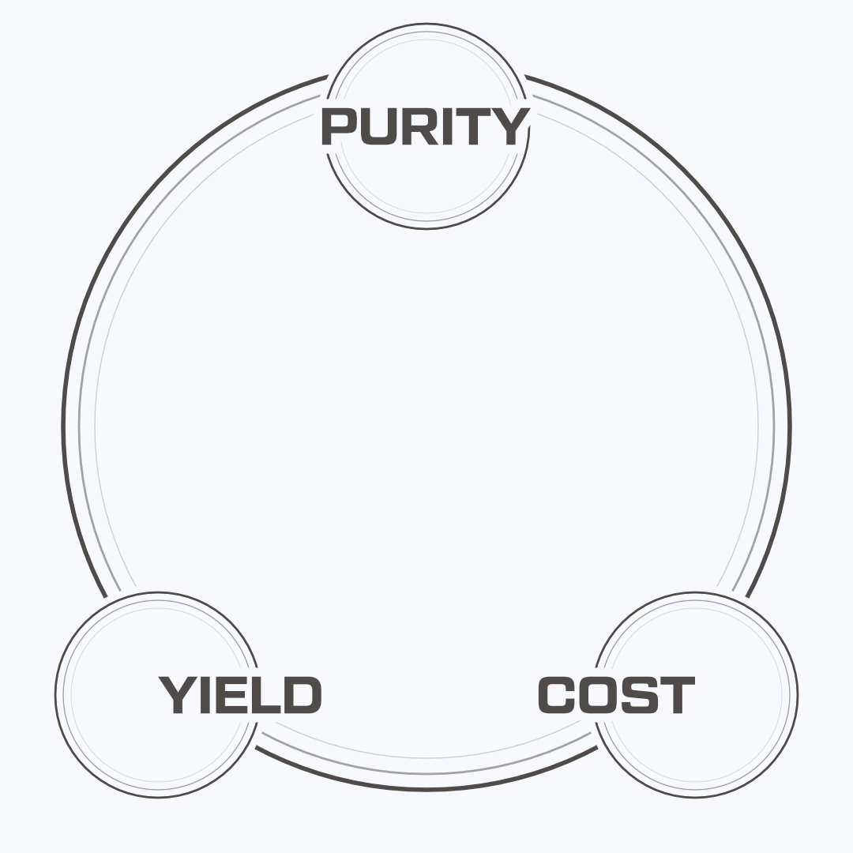
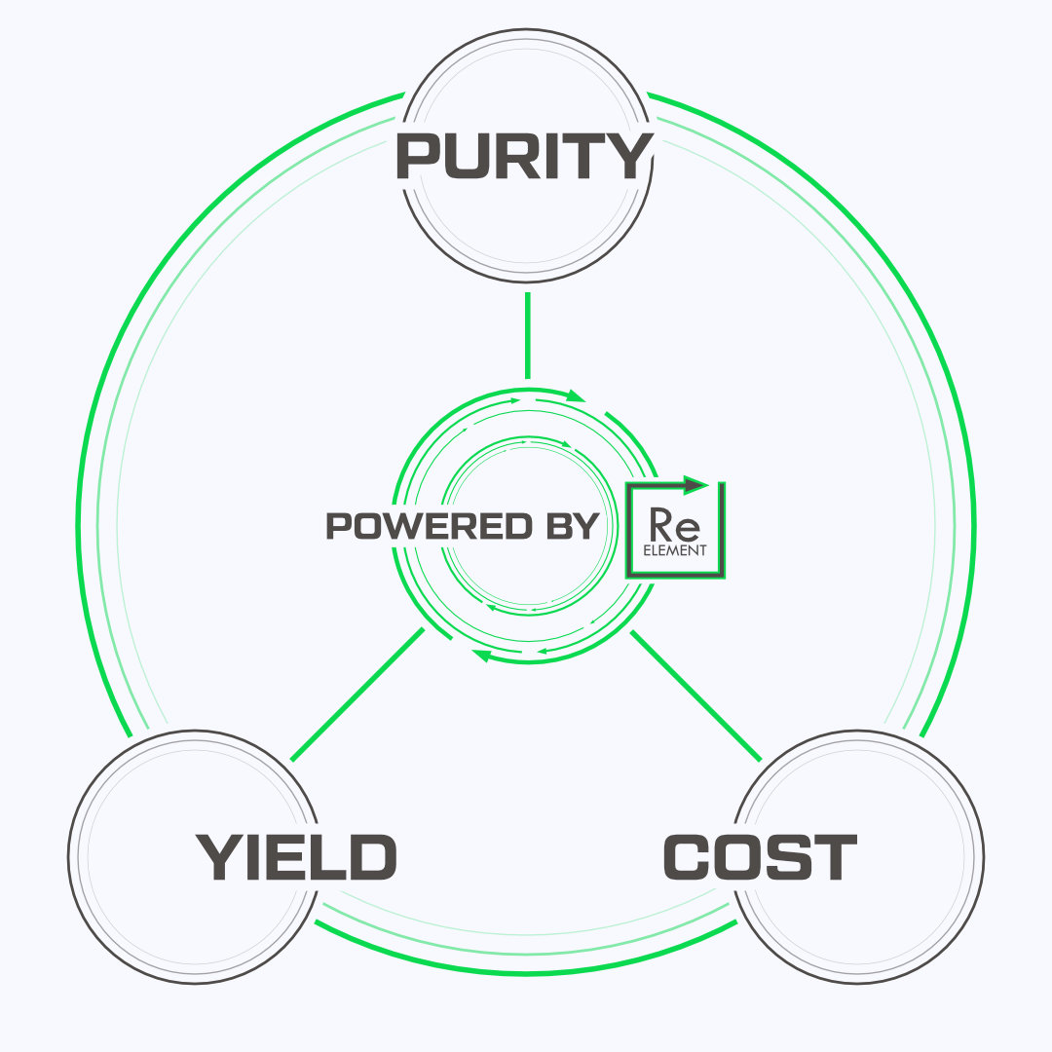
Where is your Weak Link?
Powered by ReElement: A Solution Unlocking All Three for your Process

Slide 5
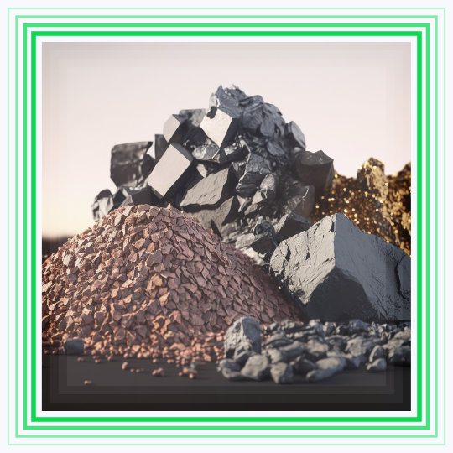
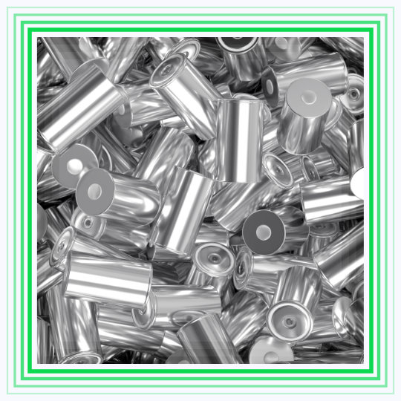
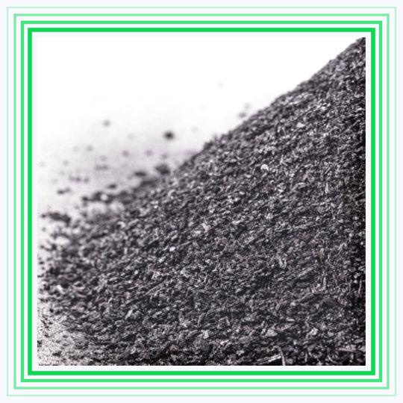
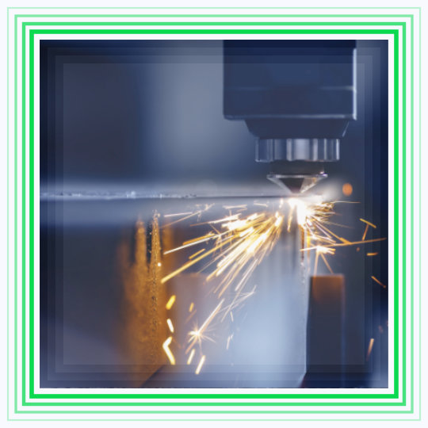
Powered by ReElement: Feedstock Agnostic Refining
Bespoke Calibration to Plug-and-Process all Magnet and Battery Feedstock Types and Chemistries
Natural Mineral Feedstock
Recycled Batteries
Li-Battery Black Mass
CAM & Battery Cell Manufacturing Byproducts
Lithium Spodumene Ores
Lithium Lepidolite Ores
Lithium Mineral Brines
End-of-Life Li-Batteries
Off-Spec Li-Batteries
Shredded Li-Batteries
LFP Black Mass
NMC Black Mass

Slide 6
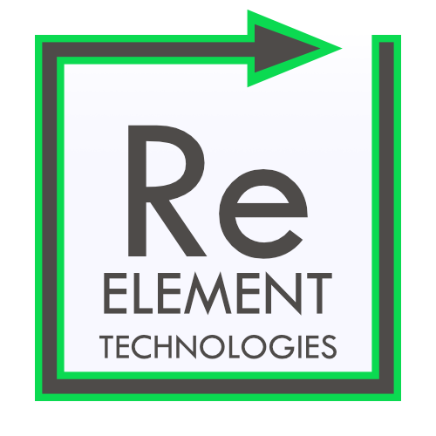
ReElement Technologies
A subsidiary of American Resources Corporation (NASDAQ: AREC)
www.reelementtech.com ▫︎ info@reelementtech.com ▫︎ @reelementtech

